Slide 1
Computational Systems Biology for Medical Applications Summary of Approach to Modeling Game
Joseph L. Hellerstein*
Herbert Sauro**
*eScience Institute, Computer Science & Engineering
**BioEngineering

Slide 2
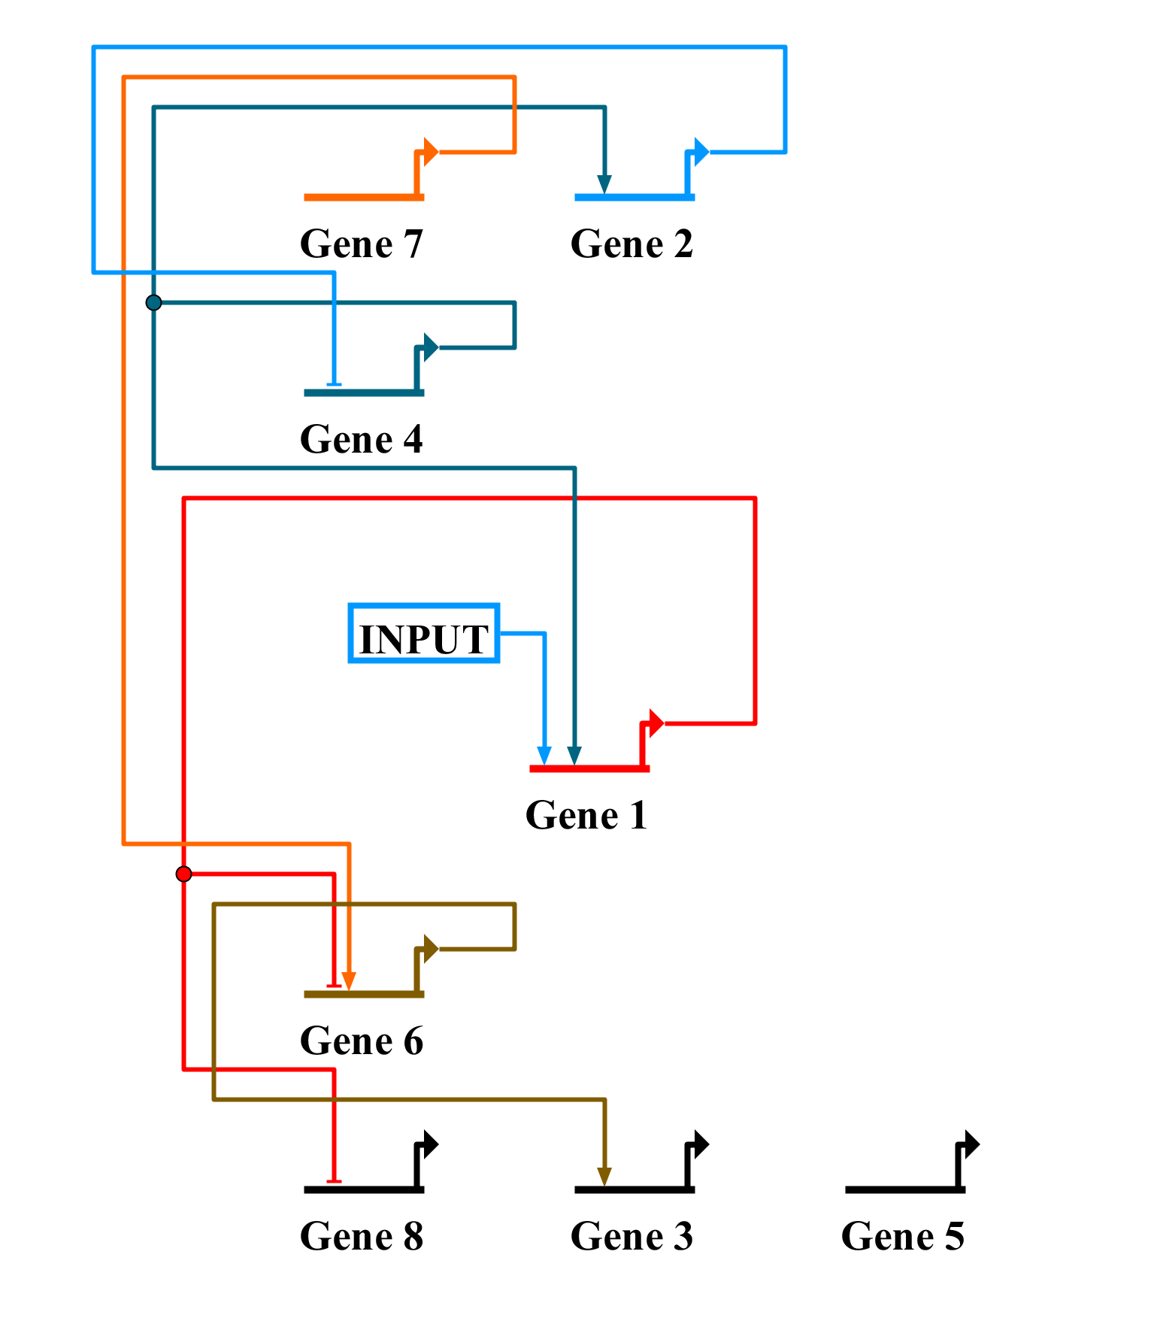
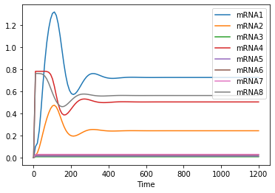
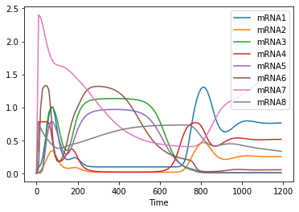
Modeling Game
Simulation of Base Model
mRNA Measurements
Now what?

Slide 3
Objective
Discover the GRN only using wild type mRNA (or protein) data

Slide 4
Challenges
Combinatorics of possible networks (within the game constraints)
17 possibilities for each TF (8 activate + 8 inhibit + None)
9 ”absent” TFs
17⁹ ~12T
Computation time due to
Number of parameters to estimate and simulation length

Slide 5
Strategies
Qualitative analysis to form hypotheses about network connections
Limits search space
Computation to select best hypotheses
But fitting even 10 parameters takes a LONG time.

Slide 6
Core Idea
Decoupling the genes means decoupling their kinetics equations
Reduces the combinatorics to 17*9 network evaluations from 17⁹ network evaluations.
Still need qualitative approach since this is too much to “brute force” on a laptop.
Decouple by using observations of protein instead of simulated values.
Challenge: I’m using mRNA, not protein
Solution: Estimate proteins from mRNA using numerical integration of the kinetics equations

Slide 7
Workflow
Estimate proteins from observations of mRNA
For each gene
Use qualitative analysis to select candidate transcription factors
Evaluate using numerical integration and the estimated protein data
Select the best set of transcription factors and record the parameter estimates
Use the above parameter estimates as a starting point for a full optimization of the identified GRN.

